Slide 1

Customer Distribution and Deactivation Analysis
Telecom Company
-Bindiya Singh

Slide 2
AGENDA
_______________________________________________________________________________________________________________________________________________________________________________
Objective
Description of Dataset and Variables
Key Findings
Statistical Tests
Recommendations
Conclusion
Appendix

Slide 3
OBJECTIVE
_______________________________________________________________________________________________________________________________________________________________________________
To investigate the customer distribution and business behaviours
To gain insightful understanding about the customers
To analyse sales performance in different segments
To segment customer accounts for better understanding about their association with other Variables
To perform various Statistical tests in support of our findings

Slide 4
Description of Dataset and Variables
_______________________________________________________________________________________________________________________________________________________________________________
The CRM data of a wireless company is for 2 years from Jan 1999 to Jan 2001. The dataset will be used for analyses related to customer behavior, sales performance, and account management
Interpretation of the columns:
Obs: Observation number or index.
Acctno (Account Number): Unique identifier for each account.
Actdt (Activation Date): Date when the account was activated.
Deactdt (Deactivation Date): Date when the account was deactivated. If the account is still active, this field may contain a dot or be empty.
Deactreason (Deactivation Reason): Reason for deactivation (e.g., "NEED," "MOVE").
Goodcredit: Indicator for good credit (0 or 1).
Rateplan (Rate Plan): Rate plan identifier.
Dealertype (Dealer Type): Dealer type identifier.
AGE: Age of the account holder.
Province: Province where the account is located.
11.Sales: The amount of sales to a customer.

Slide 5
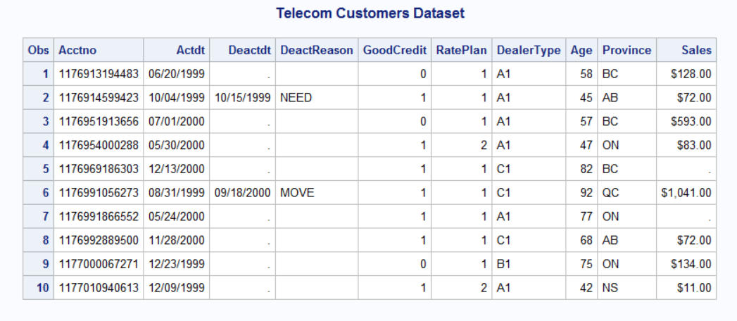
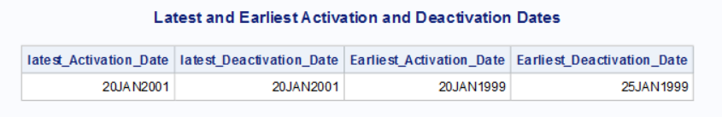
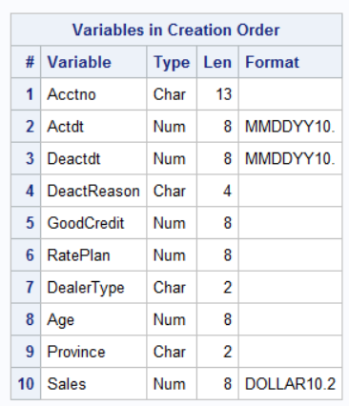
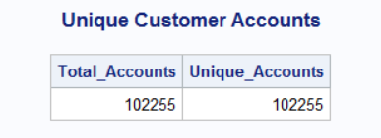
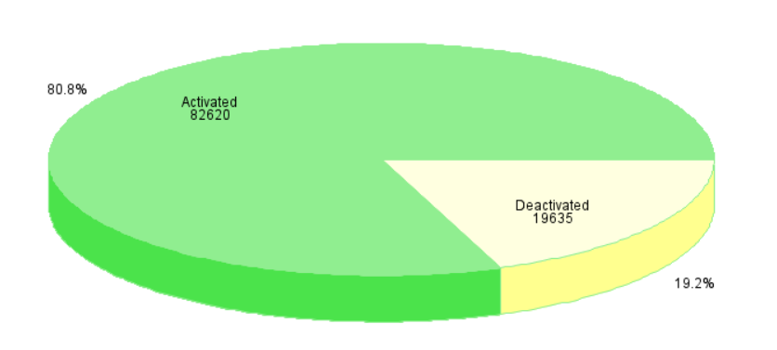
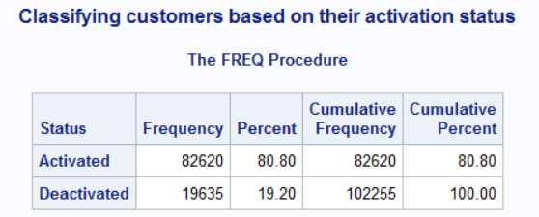
Importing and Getting Familiar with Dataset
Importing dataset into SAS
Title ’Telecom Customers Dataset';
DATA Telecom.nwf;
INFILE 'C:\Users\16479\Desktop\Data Science\ASP-ADVANCE SAS PROGRAMMING\
New_Wireless_Fixed.txt' DLM = ' ' TRUNCOVER;
INPUT
@1 Acctno $13.
@15 Actdt MMDDYY10.
@26 Deactdt MMDDYY10.
@41 DeactReason $4.
@53 GoodCredit 1.
@62 RatePlan 1.
@65 DealerType $2.
@74 Age 2.
@ 80 Province $2.
Sales DOLLAR10.2 ;
FORMAT Actdt Deactdt MMDDYY10. SALES DOLLAR10.2;
RUN;
proc print data = Telecom.nwf ( obs = 10) ;
run;
Distribution of Total Accounts

Slide 6
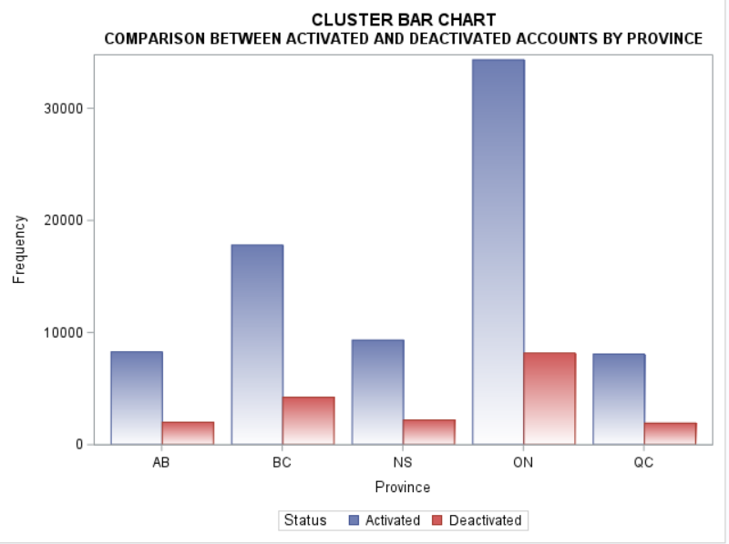
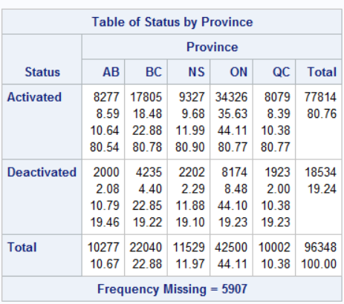
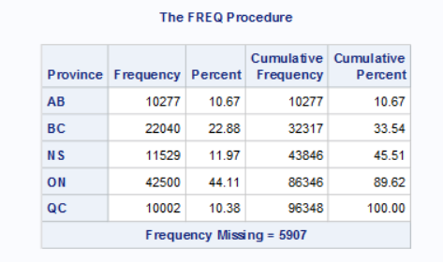
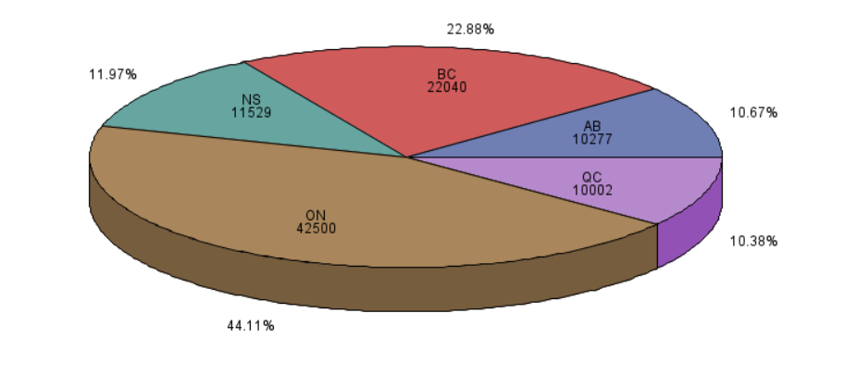
Key Findings
Overall Status Distribution by Province:
The activation and deactivation rate for all the province surrounds around 81% and 19% to the total in all province .
The company might be implementing uniform strategy across different province.
Similar Marketing approach
Customer retention strategies
Similar Customer behavior
There are 5907 missing values in Province and need further investigation.
Total Account distribution across Province

Slide 7
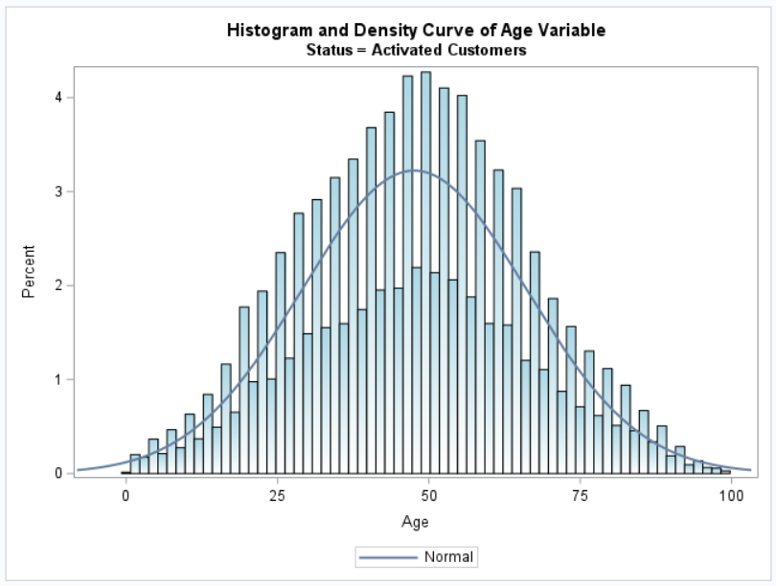
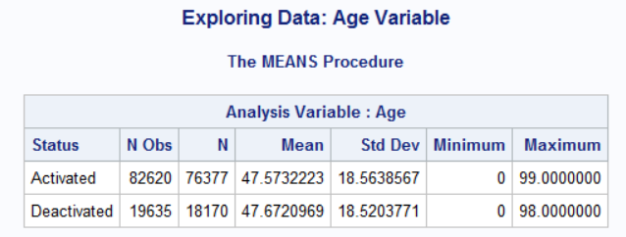
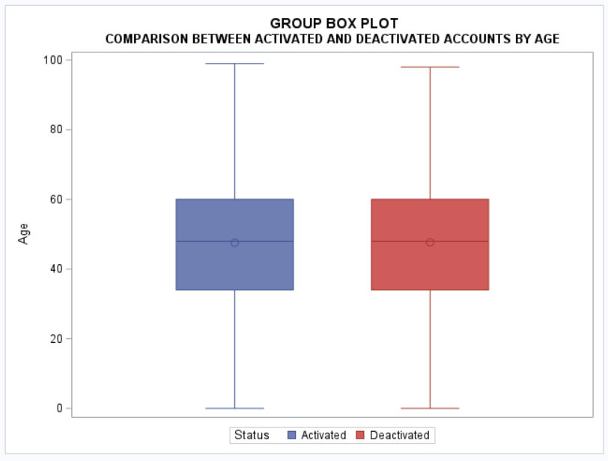
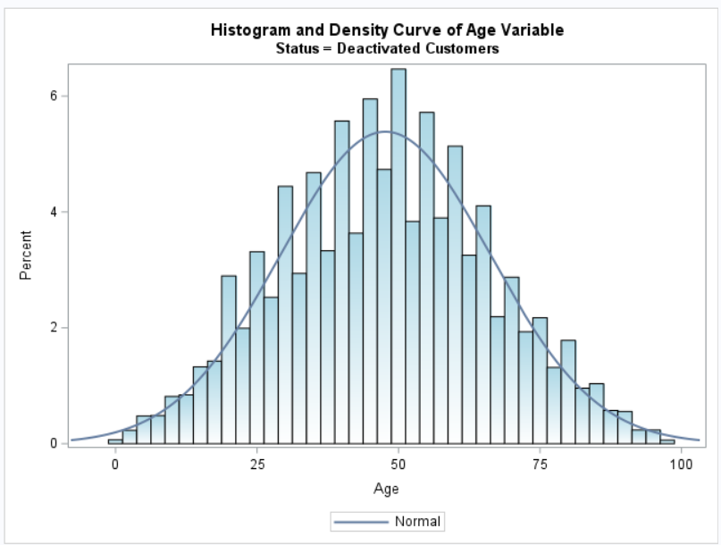
Key Findings
Overall Status Distribution by Age
Activation and deactivation predominantly occur within the middle-aged demographic.
The Age within the Status category shows no outliers.

Slide 8
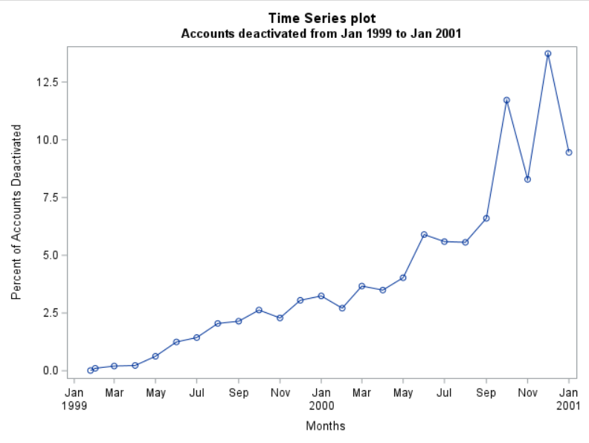
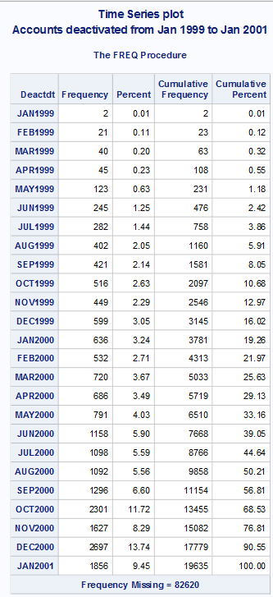
Key Findings
Accounts Deactivated from 1999 - 2001:
Deactivation exhibits a consistent upward trend from January 1999 to January 2001
The month of December 1999 and 2000 has the highest percentage of deactivations 3.05% and 13.74% , suggesting a peak in account closures relative to other months.
Competitive Offers
Technology upgrade
Contract Expirations

Slide 9
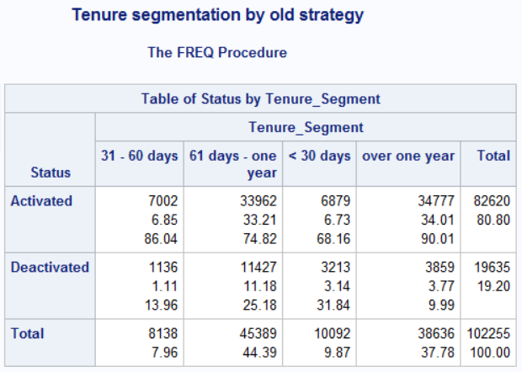
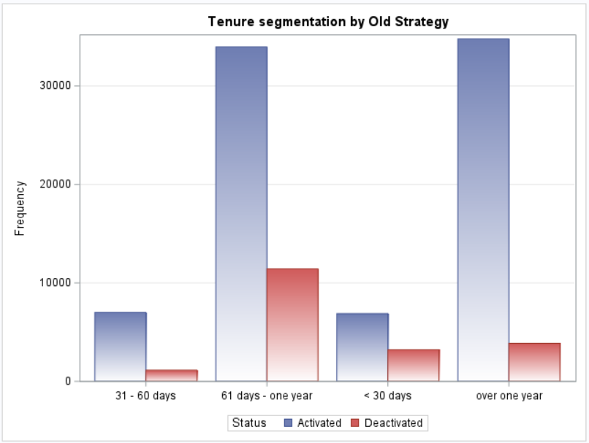
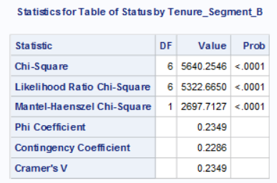
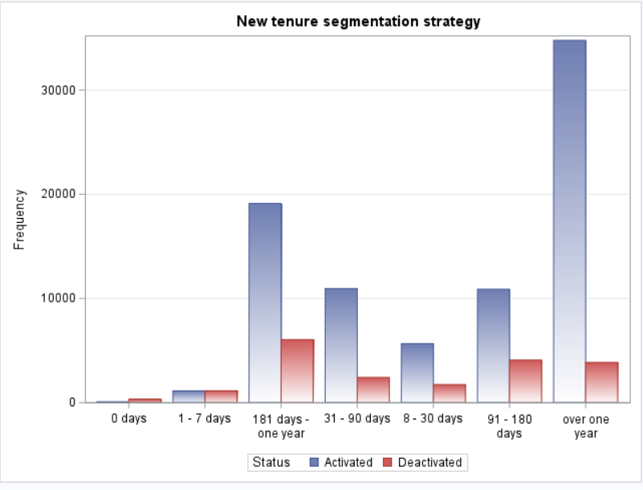
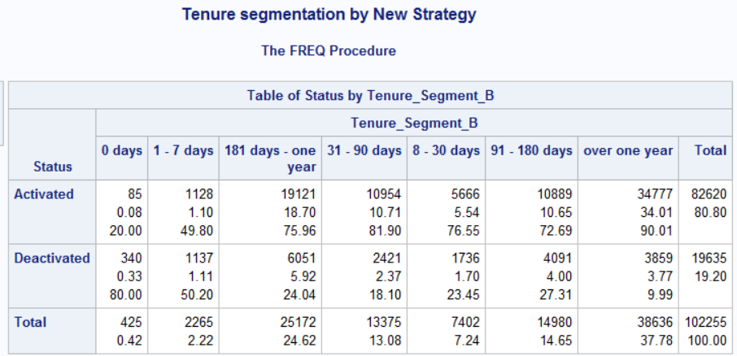
Key Findings
Status distribution across various tenure segments :
The highest total count is observed in the "over one year" tenure segment, contributing 37.78% to the total. 90.01% of the total accounts are with active status which is a good sign . The company should continue with the existing business strategies.
Short-term tenure segments such as "0 days," "1 - 7 days," have higher deactivation rates of 80% and 50% of the segment total , suggesting lower customer retention in the initial stages.

Slide 10
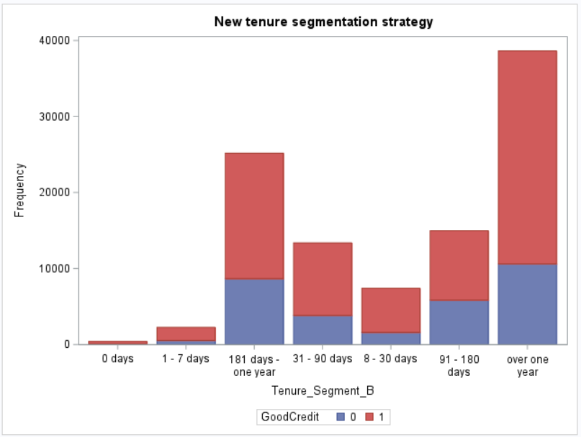
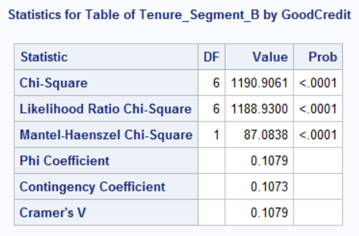
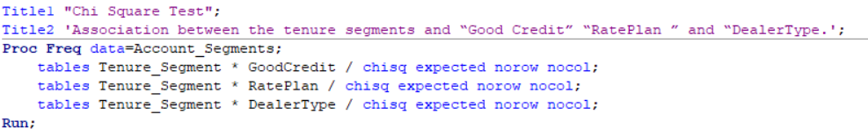
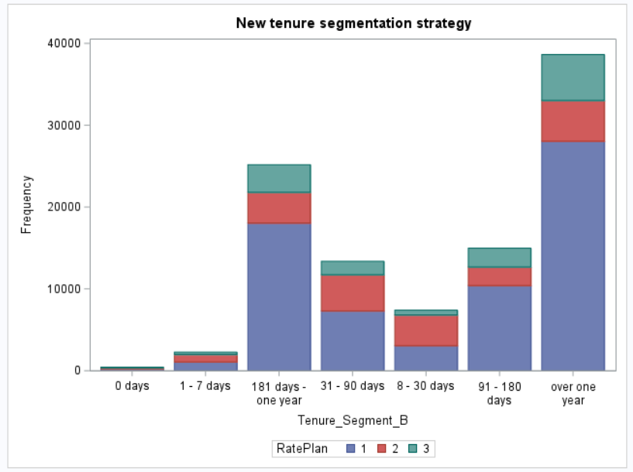
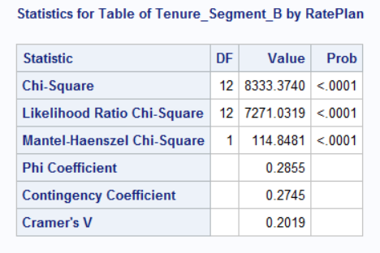
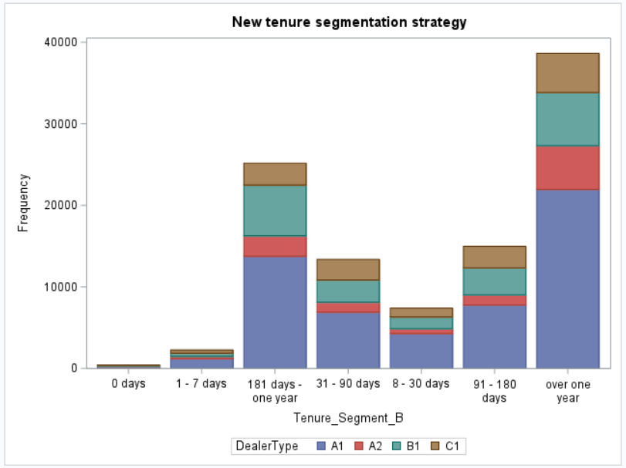
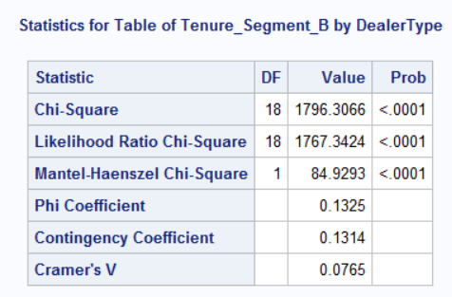
Key Findings- Chi Square test
(Association between the Tenure Segments and “Good Credit", "Rate Plan’ and “Dealer Type”)
Tenure_Segment & GoodCredit
Tenure_Segment & RatePlan
H0: There is no significant association between the Tenure segments and GoodCredit, RatePlan, DealerType.
Ha: There is an association between Tenure segments and GoodCredit, RatePlan, DealerType.
Tenure_Segment & DealerType
Conclusion:
All the Chi-Square Probability values are <.05, indicating that we can reject the null hypothesis, and conclude that there is an ASSOCIATION between the Tenure segments and GoodCredit, RatePlan, DealerType, at 5% significance level.

Slide 11
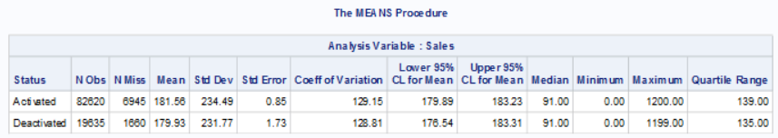
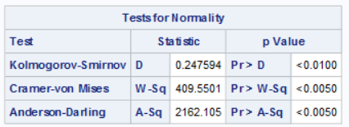
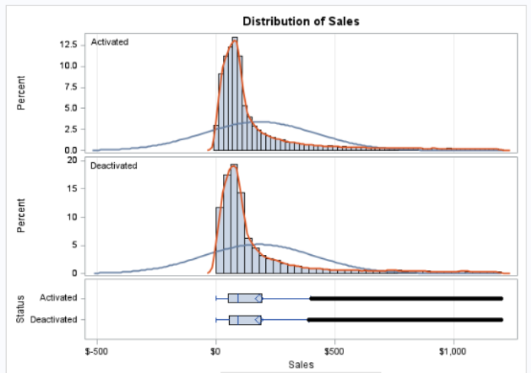
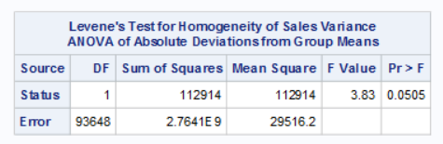
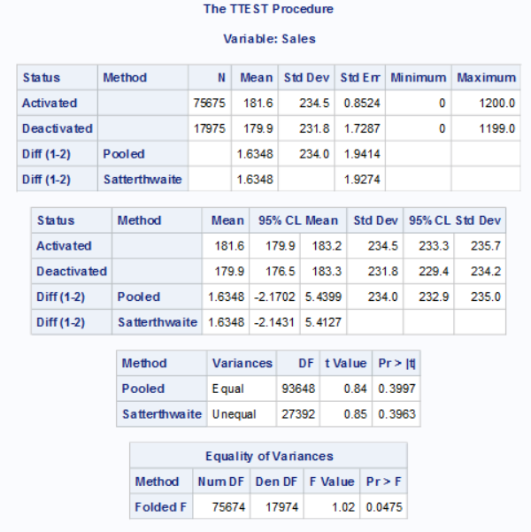
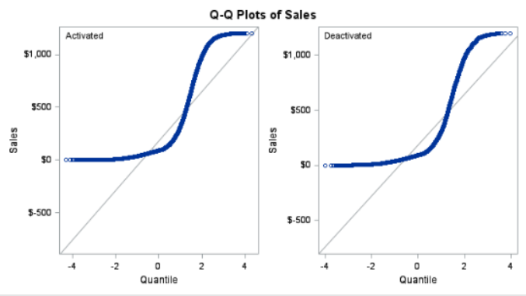
Analysis of Sales among different Account Statuses
(Independent Samples T Test )
** ( A ) Sales and Account Status;
*1) Descriptive Statistics ;
proc means data=Formatted_data nmiss mean std stderr cv lclm uclm median
min max qrange maxdec=2;
var Sales;
class Status;
run;
*2) Test of Normality ;
TITLE "Test of Normality";
PROC UNIVARIATE DATA = Formatted_data NORMAL PLOT;
CLASS STATUS;
VAR SALES;
RUN;
*As per CLT if the number of observations are above 30, the data should be considered as normal. Hence , we will perform "Equality of Variance" Test;
*3) Equality Of Variance Test;
Title ' Test of "Equality of Variance"';
Proc GLM data=Formatted_data;
class Status;
model Sales = Status;
means Status / hovtest=levene(type=abs) welch;
Run;
* H0: Equality of variance between the groups
Ha: No Equality of variance between the groups
The p-value= 0.0505, higher than 0.05, which indicates that fail to
reject the Null Hypotheses,
There is a Equality of variance between the customers holding Activation and
Deactivation Status. To support our findings we will perform T Test;
*4) T Test ;
proc ttest data=Formatted_data;
var Sales;
class Status;
run;
* H0: The mean sales for different account statuses are equal.
Ha: There is a significant difference in mean sales between different account statuses.
The p-value= 0.3997, higher than 0.05, which indicates that we fail to reject the Null
Hypothesis and conclude that there is no significant difference in mean sales between
the categories of account status at 5% significance level;

Slide 12
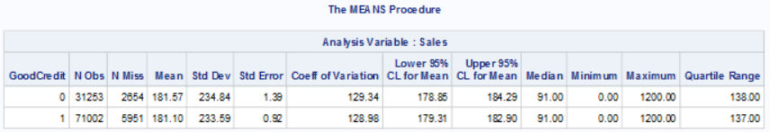
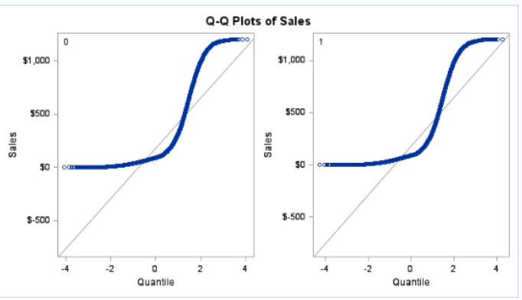
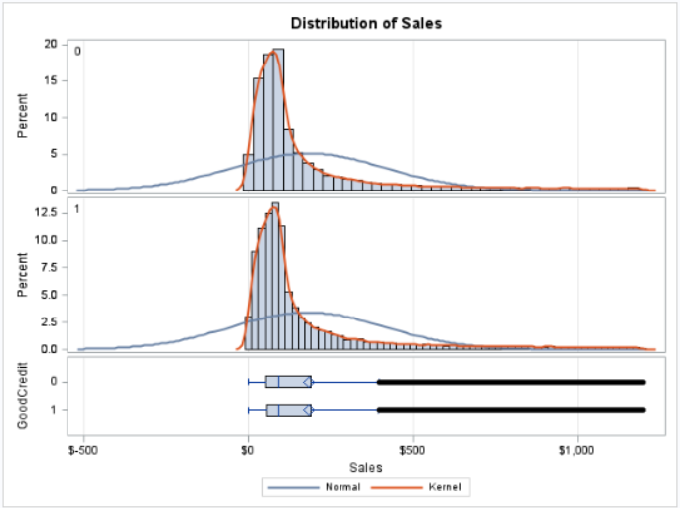
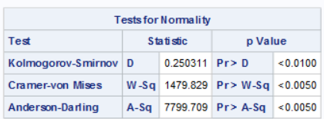
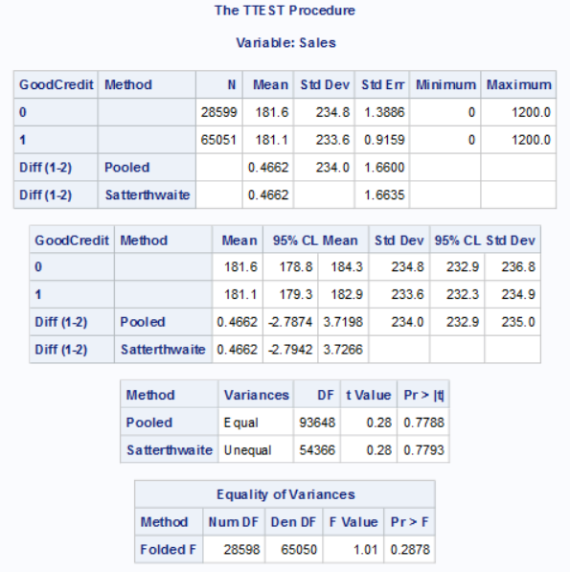
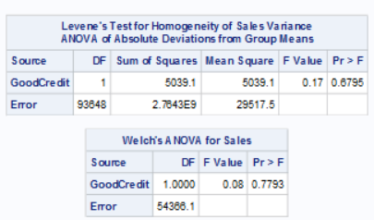
Analysis of Sales among different GoodCredit groups
(Independent Samples T Test )
( B ) Sales and GoodCredit;
*1) Descriptive Statistics;
proc means data=Formatted_data nmiss mean std stderr cv lclm uclm median min max qrange maxdec=2;
var Sales;
class GoodCredit;
run;
*2)Test of Normailty;
TITLE "Test of Normality";
PROC UNIVARIATE DATA = Formatted_data NORMAL PLOT;
CLASS GoodCredit;
VAR SALES;
RUN;
*As the number of observations are above 30 , hence we will consider the data as normally distributed .
*3) Equality of Variance Test;
Proc GLM data=Formatted_data;
class GoodCredit;
model Sales = GoodCredit;
means GoodCredit / hovtest=levene(type=abs) welch;
Run;
* H0: There is Equality of Variance between the groups
Ha: There is no Equality of Variance between the groups
The Levene's Test p-value= 0.6795, higher than 0.05, which indicates that we fail
to reject the Null Hypotheses,
we haven't found strong evidence to conclude that there is no significant
difference in the variance of the groups ;
*4) Pooled TTest;
proc ttest data = Formatted_data;
var Sales;
class GoodCredit;
run;
*H0: The mean sales for different groups of Goodcredit are equal.
Ha: There is significant difference in mean sales between different groups of
GoodCredit.
The p-value= 0.7788, higher than 0.05, which indicates that we can not reject the
Null Hypothesis and conclude that there is no significant difference in mean sales
between the groups of GoodCredit at 5% significance level;

Slide 13
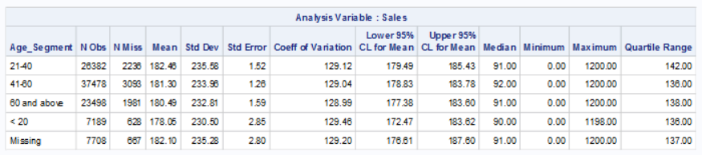
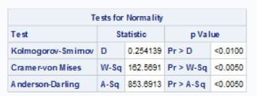
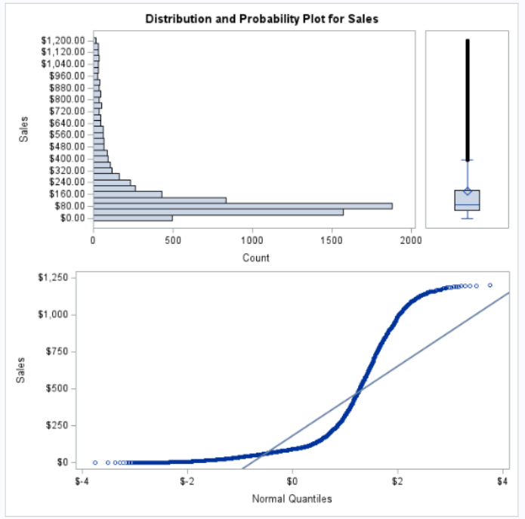
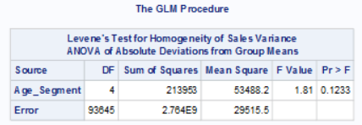
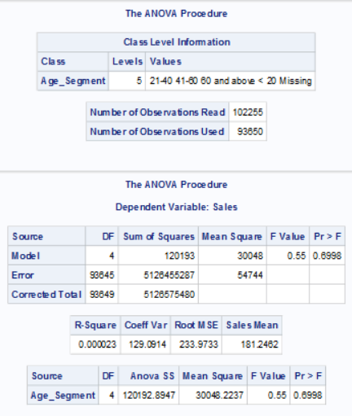
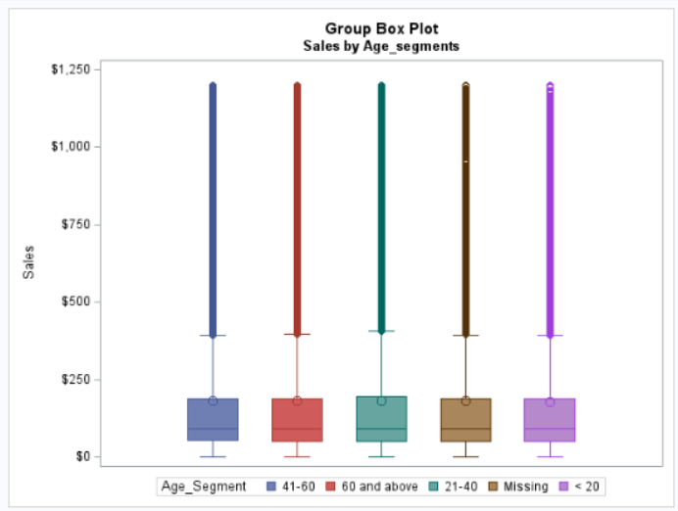
Analysis of Sales in different Age Segments
(One way ANOVA Test)
( C ) Sales and Age segments;
*1) Descriptive Statistics;
proc means data=Formatted_data nmiss mean std stderr cv
lclm uclm median min max qrange maxdec=2;
var Sales;
class Age_segment;
run;
*2) Test of Normality;
TITLE "Test of Normality";
PROC UNIVARIATE DATA = Formatted_data NORMAL PLOT;
CLASS Age_Segment;
VAR SALES;
RUN;
* The number of observations are above 30, we will consider the data as normally distributed.
*3)Equality of Variance Test;
Proc GLM data=Formatt_Segments;
class Age_Segment;
model Sales = Age_Segment;
means Age_Segment / hovtest=levene(type=abs) welch;
Run;
* H0: There is Equality of Variance between different Age Segments.
Ha: There is no Equality of Variance between different Age Segments.
The Levene's Test p-value= 0.1233, higher than 0.05, which indicates that we can not reject the Null Hypotheses, as we haven't found strong evidence to conclude that there is no significant difference in Variance among different age segments we will perform One Way ANOVA test;
*4) One Way ANOVA test;
Proc ANOVA data=Formatted_data;
class Age_Segment;
model Sales = Age_Segment;
means Age_Segment;
Run;
Quit;
*H0: There is no difference between the mean sales of age segment groups.
Ha: The mean sales of at least one Age segment group differs.
The p-value= 0.6998, higher than 0.05, which indicates that we fail to reject the Null Hypotheses at 5% significance level and conclude that there is no difference between the mean sales of age segment groups;

Slide 14
Recommendations
The company can capitalize on the identified associations and enhance its ability to meet the diverse needs of customers across various tenure segments. This approach can contribute to improved customer satisfaction and overall business success.
The company can start various year end promotions to reduce account closures : Contract Renewal Incentives
Customer Feedback Surveys
Bundle Offers and Upgrades
For middle aged demographics, the company should start with -
Personalized offers and discounts
Value added services – Family plans
Retention focused loyalty programs –For completing number of years
Timely Communication and Engagement to customer needs

Slide 15
Conclusion
The company should focus on improving customer retention strategies for short-term tenure segments, monitor and address deactivation trends over time, and consider the identified factors influencing deactivations. Additionally, the insights from the analysis can guide the company in refining its business strategies and better understanding customer behavior.

Slide 16
THANK YOU

Slide 17
APPENDIX
Two year’s CRM data is available
The Statistic Analysis is as the followings
1.1 Explore and description of dataset
1.2 Customer’s distribution
1.3 Segmentation
1.4 Statistic analysis
1.4.1 Tenure
1.4.2 Inactive distribution
1.4.3 Tenure segmentation
1.4.4 Status distribution by segment
1.4.5 Relationship between tenure segments vs. GoodCredit, RatePlan, DealerType
1.4.6 Sales study

Slide 18
Description of Dataset and Variables
The CRM data of a wireless company is for 2 years from Jan 1999 to Jan 2001. The dataset will be used for analyses related to customer behavior, sales performance, and account management
Interpretation of the columns:
Obs: Observation number or index.
Acctno (Account Number): Unique identifier for each account.
Actdt (Activation Date): Date when the account was activated.
Deactdt (Deactivation Date): Date when the account was deactivated. If the account is still active, this field may contain a dot or be empty.
Deactreason (Deactivation Reason): Reason for deactivation (e.g., "NEED," "MOVE").
Goodcredit: Indicator for good credit (0 or 1).
Rateplan (Rate Plan): Rate plan identifier.
Dealertype (Dealer Type): Dealer type identifier.
AGE: Age of the account holder.
Province: Province where the account is located.
11.Sales: The amount of sales to a customer.

Slide 19
Importing dataset in SAS
Title ’Telecom Customers Dataset';
DATA Telecom.nwf;
INFILE 'C:\Users\16479\Desktop\Data Science\ASP-ADVANCE SAS PROGRAMMING\New_Wireless_Fixed.txt' DLM = ' ' TRUNCOVER;
INPUT @1 Acctno $13. @ 15 Actdt MMDDYY10. @ 26 Deactdt MMDDYY10. @41 DeactReason $4. @53 GoodCredit 1. @62 RatePlan 1. @65 DealerType $2. @74 Age 2. @ 80 Province $2. Sales DOLLAR10.2 ;
FORMAT Actdt Deactdt MMDDYY10. SALES DOLLAR10.2;
RUN;
proc print data = Telecom.nwf ( obs = 10) ;
run;
proc contents data = Telecom.nwf order = varnum; run;

Slide 20
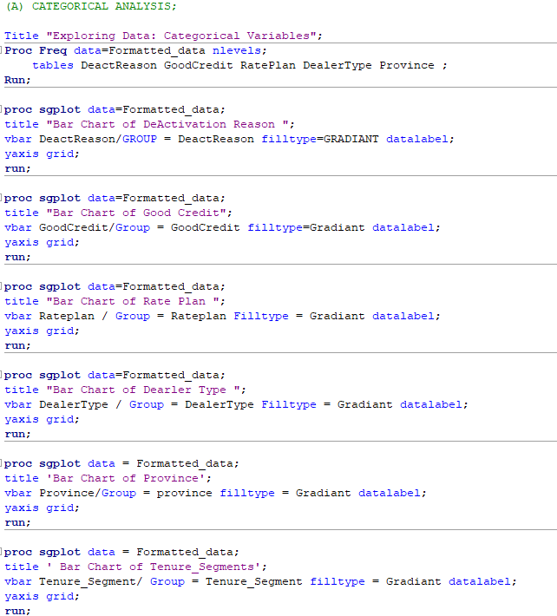
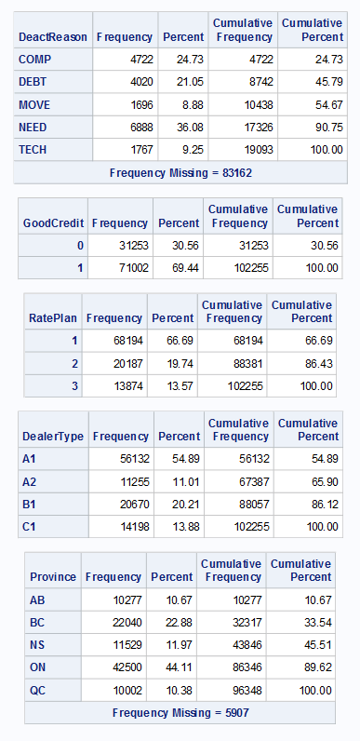
UNIVARIATE ANALYSIS
(Categorical Variables)

Slide 21
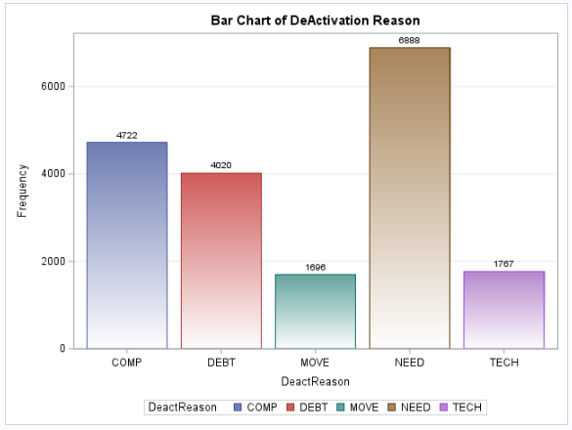
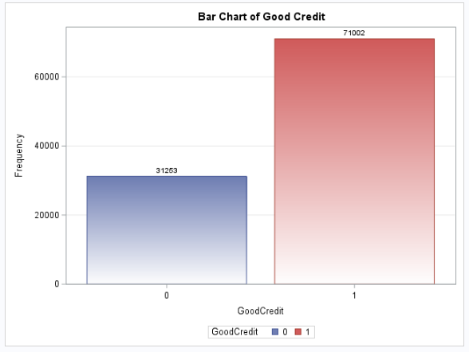

UNIVARIATE ANALYSIS
(Categorical Variables)
Deactivation Variable
Good Credit
Rate Plan
The table provides the frequency distribution of deactivation reasons, indicating the number and percentage of occurrences for each reason. The most common reasons for deactivation include "COMP" (24.73%), "DEBT" (21.05%), "MOVE" (8.88%), "NEED" (36.08%), and "TECH" (9.25%). The cumulative percentages show the proportion of total deactivations attributed to each reason. Additionally, there are 83,162 missing values in the dataset.
This table essentially shows the distribution of individuals based on their credit status. The majority (69.44%) fall into the "GoodCredit 1" category, while 30.56% are in the "GoodCredit 0" category. The cumulative frequencies provide a running total, illustrating the overall distribution of the dataset.
This table provides an overview of the distribution of individuals across three rate plans. The majority (66.69%) are under RatePlan 1, followed by RatePlan 2 with 19.74%, and RatePlan 3 with 13.57%. The cumulative frequencies and percentages show the overall composition of the dataset, with the cumulative percent reaching 100.00% at the end.

Slide 22


UNIVARIATE ANALYSIS
(Categorical Variables)
Dealer Type
Province
This table provides an overview of the distribution of individuals across four dealer types. The majority (54.89%) belong to DealerType A1, followed by A2 with 11.01%, B1 with 20.21%, and C1 with 13.88%. The cumulative frequencies and percentages depict the overall composition of the dataset, with the cumulative percent reaching 100.00% at the end.
This table provides a breakdown of the dataset based on provinces. The majority of individuals are from Ontario (ON) with 44.11%, followed by British Columbia (BC) with 22.88%, Nova Scotia (NS) with 11.97%, Alberta (AB) with 10.67%, and Quebec (QC) with 10.38%. The cumulative frequencies and percentages show the overall composition of the dataset, with a note about missing data for 5,907 individuals.

Slide 23





UNIVARIATE ANALYSIS
(Numerical Variable – Age and Sales)
Title "Exploring Data: Continuous Variables";
Proc Means data=Formatted_data;
var Age Sales;
Run;
Proc Univariate data=Formatted_data normal;
var Age Sales;
histogram Age Sales / normal;
Run;

Slide 24



Business Requirements
1.1 Explore and describe the dataset briefly. For example, is the acctno unique? What is the number of accounts activated and deactivated? When are the earliest and latest activation/deactivation dates available
*** Distinct account number;
proc sql;
select count(distinct Acctno) as Unique_Accounts
from Telecom.nwf ;
quit;
proc contents data = Telecom.nwf;run;
Title 'Total Number of Activated Accounts';
proc sql;
select count(Acctno) as Activated_Accounts
from Telecom.nwf
where actdt is not null and deactdt is null;
quit;
The number of activated accounts are 82620;
Title ' Total Number of deactivated Accounts';
proc sql;
select count(Acctno) as DeActivated_Accounts
from Telecom.nwf
where deactdt is not null;
quit;
The number of deactivated accounts is 19635;
Title "Classifying customers based on their activation status";
Data Status_ActDeact;
set Telecom.nwf;
if not missing(Deactdt) then Status = 'Deactivated';
else if not missing(Actdt) and missing(Deactdt)
then Status = 'Activated';
else Status = 'Unknown';
Run;

Slide 25

Business Requirements
1.1 Explore and describe the dataset briefly. For example, is the acctno unique? What is the number of accounts activated and deactivated? When are the earliest and latest activation/deactivation dates available
Proc Freq data=Status_ActDeact;tables status;Run;
TITLE "UNIVARIATE ANALYSIS";
TITLE " PIE CHART SHOWING CLASSIFICATION OF STATUS";
PROC GCHART DATA= Status_ActDeact;
PIE Status /DISCRETE VALUE = INSIDE PERCENT=OUTSIDE;
GOPTIONS COLORS = (LIGHTGREEN lightblue);
RUN;
QUIT;
Title ' Latest and Earliest Activation and Deactivation Dates';
proc sql;
select max(actdt)as latest_Activation_Date format =date9.,
max(deactdt) as latest_Deactivation_Date format=date9.,
min(actdt)as Earliest_Activation_Date format =date9.,
min(deactdt) as Earliest_Deactivation_Date format=date9.
from Telecom.nwf;
quit;
1.2 What are the age and province distributions of active and deactivated customers?;
Title "Age and Province distributions of activated and deactivated customers";
Proc Freq data=Status_ActDeact nlevels;
tables Status * Age / nocum norow nocol;
tables Status * Province / nocum ;
Run;
Title1 'Histogram and Density Curve of Age Variable';
Title2 'Status = Activated Customers';
Proc Sgplot data=Status_ActDeact;
histogram Age/fillattrs=(color=lightblue)filltype=gradient;
density Age;
where Status = 'Activated';
Run;

Slide 26



Business Requirements
Proc Sgplot data=Status_ActDeact;
Title1 'Histogram and Density Curve of Age Variable';
Title2 'Status = Deactivated Customers';
histogram Age/fillattrs=(color=lightblue)filltype=gradient;
density Age;
where Status = 'Deactivated';
Run;
proc freq data = Status_ActDeact;
table province;
run;
TITLE1 "CLUSTER BAR CHART ";
TITLE2 "COMPARISON BETWEEN ACTIVATED AND DEACTIVATED ACCOUNTS BY PROVINCE ";
PROC SGPLOT DATA = Status_ActDeact;
VBAR PROVINCE / GROUP = STATUS GROUPDISPLAY=CLUSTER FILLTYPE = GRADIENT;
RUN;
TITLE1 ' GROUP BOX PLOT ';
TITLE2 'COMPARISON BETWEEN ACTIVATED AND DEACTIVATED ACCOUNTS BY AGE';
PROC SGPLOT DATA = Status_ActDeact;
VBOX AGE / GROUP = STATUS;
RUN;
The output presents a histogram and density curve of the "Age" variable for customers with a status of "Deactivated." Additionally, it provides a frequency distribution of the "Province" variable for these deactivated customers.
Histogram and Density Curve of Age Variable (Deactivated Customers):
The histogram visually displays the distribution of ages for customers with a "Deactivated" status.
The density curve represents the smoothed distribution of ages.
Frequency Distribution of Province for Deactivated Customers:
Province AB: 10.67% of deactivated customers are from Alberta (AB).
Province BC: 22.88% of deactivated customers are from British Columbia (BC).
Province NS: 11.97% of deactivated customers are from Nova Scotia (NS).
Province ON: 44.11% of deactivated customers are from Ontario (ON).
Province QC: 10.38% of deactivated customers are from Quebec (QC).
Frequency Missing: There are 5,907 missing values for the "Province" variable among deactivated customers.
In summary, the visual representation of the age distribution and the frequency distribution of provinces provides insights into the characteristics of deactivated customers, including their age distribution and geographical distribution across different provinces.

Slide 27


Business Requirements
1.3 Segment the customers based on age, province, and sales amount:
Sales segment: < $100, $100-$500, $500-$800, $800 and above.
Age segments: < 20, 21-40, 41-60, 60 and above.
proc format ;
value Age_segm
.= 'Missing'
low -< 21 = '< 20'
21 -< 41 = '21-40'
41 -< 61 = '41-60'
61 - High = '60 and above';
value Sales_segm
. ='Missing'
low -< 100 = '< $100'
100 -< 500 = '$100-$500'
500 -< 800 = '$500-$800'
800 - High = '$800 and above';
Run;
Title ' Segmentation of the customers based on Age, province
and Sales Amount ';
proc Tabulate data = Status_ActDeact;
class Status Age Province Sales ;
format Age Age_segm. Sales Sales_segm.;
tables Status, Age*(n) Province*(n) Sales*(n);
run;
data Formatted_data;
set Status_ActDeact;
format sales sales_segm. age age_segm.;
run;
proc print data = Formatted_data ( obs=10);
run;

Slide 28




Business Requirements
1.4. Statistical Analysis:
Calculate the tenure in days for each account
and give its simple statistics.
Title "Tenure in days for each account -[From 01/20/1999 To 01/20/2001]";
Data Tenure_Days;
set Status_ActDeact;
if not missing(Deactdt) then Tenure = Deactdt - Actdt;
else if not missing(Actdt) and missing(Deactdt) then Tenure
= '20JAN2001'd - Actdt;
Run;
Proc Print data=Tenure_Days (obs=5);Run;
Proc Means data=Tenure_Days Missing Exclusive;
var Tenure;
class Status;
output out=Tenure_stats mean=Mean median=Median min=Min
max=Max p25=Q1 p75=Q3 std=StdDev;
Run;
Proc Print data=Tenure_stats;Run;
TITLE1 ' GROUP BOX PLOT ';
TITLE2 'COMPARISON BETWEEN TENURE AND ACCOUNT STATUS';
PROC SGPLOT DATA = TENURE_DAYS;
VBOX TENURE / GROUP = STATUS;
RUN;
proc univariate data = Tenure_Days normal plot;
var tenure;
where status = 'Activated';
run;

Slide 29





Business Requirements
1.4. Statistical Analysis:
2) Calculate the number of accounts deactivated for each month.
Data Tenure_Month;
set Tenure_Days;
if not missing(Deactdt) then Tenure_Mon = intck('month',Actdt,Deactdt);
else if not missing(Actdt) and missing(Deactdt) then
Tenure_Mon = intck('month',Actdt,'21Jan2001'd);
Run;
Proc Print data=Tenure_Month(obs=10);Run;
Proc Freq data=Tenure_Month;
tables Deactdt / out=Deact_MonthCounts;
format Deactdt monyy7.;
Run;
Data Deact_MonthCounts;
set Deact_MonthCounts;
if _n_ ne 1;
Run;
Proc Print data=Deact_MonthCounts;Run;
proc sgplot data = Deact_Monthcounts;
series x = deactdt y = percent /markers;
xaxis display=(nolabel) valuesformat = monname3.;
xaxis label = 'Months';
yaxis label ='Percent of Accounts Deactivated';
title1 'Time Series plot';
title2 'Accounts deactivated from Jan 1999 to Jan 2001’;
proc sgplot data = Deact_1999 ;
series x=deactdt y=percent / markers;
xaxis display=(nolabel) valuesformat=monname3.;
yaxis display =(nolabel);
yaxis label = 'Percent';
title 'Time Series Plot for 1999';run;
proc sgplot data = Deact_2000;
series x=deactdt y = percent / markers;
xaxis display =(nolabel) valuesformat = monname3.;
yaxis display =(nolabel);
yaxis label = 'Percent';
title 'Time Series Plot for 2000';run;
proc print data = Deact_1999;run;
title 'Accounts Deactivated in 1999';
Proc print data = Deact_2000;run;
title ' Accounts Deactivated in 2000';

Slide 30


Business Requirements
1.4. Statistical Analysis:
3) Segment the account, first by account status “Active” and “Deactivated”, then by
Tenure: < 30 days, 31---60 days, 61 days--- one year, over one year. Report the
number of accounts of percent of all for each segment. .
Title "Number of accounts in each segment";
Data Account_Segments;
set Tenure_Month;
if Tenure =< 30 then Tenure_Segment = '< 30 days ';
else if Tenure <= 60 then Tenure_Segment = '31 - 60 days';
else if Tenure <= 365 then Tenure_Segment = '61 days - one year';
else Tenure_Segment = 'over one year';
Run;
proc print data = Account_segments (obs=10);
run;
Title1 'Frequency Table';
Title2 'Status & Tenure Segment';
Proc Freq data=Account_Segments;
table Status * Tenure_Segment / out=Segmented_Counts outpct norow nocol;
Run;
proc sort data=Segmented_Counts;
by descending Status descending Percent ;
run;
Proc Print data=Segmented_Counts noobs;
var Status Tenure_Segment Count Percent;
Run;
Title 'Cluster Bar Chart - Tenure Segment and Customer Account Status';
proc sgplot data = segmented_counts;
vbar tenure_segment/response = percent group= status groupdisplay=cluster filltype=gradient;
yaxis label = 'Percentage';
run;

Slide 31



Business Requirements
1.4. Statistical Analysis:
4) Test the general association between the tenure segments and “Good Credit”
“RatePlan ” and “DealerType.”
Title1 "Chi Square Test";
Title2 'Association between the tenure segments and “Good Credit” “RatePlan ” and “DealerType.';
Proc Freq data=Account_Segments;
tables Tenure_Segment * GoodCredit / chisq expected norow nocol;
tables Tenure_Segment * RatePlan / chisq expected norow nocol;
tables Tenure_Segment * DealerType / chisq expected norow nocol;
Run;

Slide 32


Business Requirements
1.4. Statistical Analysis:
5) Is there any association between the account status and the tenure segments?
Could you find a better tenure segmentation strategy that is more associated with the account status?
Title "Chi Square Test - Association between the account status and the tenure segments";
Proc Freq data=Tenure_Segments_opt;
tables Status * Tenure_Segment_B / chisq expected norow nocol;
Run;
Title "New tenure segmentation strategy";
Data Tenure_Segments_Opt;
set Account_Segments;
if Tenure = 0 then Tenure_Segment_B = '0 days ‘;
else if Tenure =< 7 then Tenure_Segment_B = '1 - 7 days';
else if Tenure =< 30 then Tenure_Segment_B = '8 - 30 days';
else if Tenure <= 90 then Tenure_Segment_B = '31 - 90 days';
else if Tenure <= 180 then Tenure_Segment_B = '91 - 180 days';
else if Tenure <= 365 then Tenure_Segment_B = '181 days –
one year';
else Tenure_Segment_B = 'over one year';
Run;
Proc Freq data=Tenure_Segments_Opt ;
tables Status * Tenure_Segment_B /out=New_tenure_segm
outpct nocum norow ;
Run;
Proc Sgplot data=Tenure_Segments_Opt;
vbar Tenure_Segment_B / stat=sum group=Status
groupdisplay=cluster filltype = gradient ;
xaxis display=(nolabel);
yaxis grid;
Run;

Slide 33
Analysis of Sales among different Account Statuses
(Independent Samples T Test )
** ( A ) Sales and Account Status;
*1) Descriptive Statistics ;
proc means data=Formatted_data nmiss mean std stderr cv lclm uclm median
min max qrange maxdec=2;
var Sales;
class Status;
run;
*2) Test of Normailty ;
TITLE "Test of Normality";
PROC UNIVARIATE DATA = Formatted_data NORMAL PLOT;
CLASS STATUS;
VAR SALES;
RUN;
*The p value is less than .05 and indicates the data is not normally distributed , but as per CLT if the number of observations are above 30, the data should be considered as normal.
Hence , we will perform "Equality of Variance" Test;
*3) Equality Of Variance Test;
Title ' Test of "Equality of Variance"';
Proc GLM data=Formatted_data;
class Status;
model Sales = Status;
means Status / hovtest=levene(type=abs) welch;
Run;
* H0: Equality of variance between the groups
Ha: No Equality of variance between the groups
The Levene's Test p-value= 0.0505, higher than 0.05, which indicates that fail to
reject the Null Hypotheses,
There is a Equality of variance between the customers holding Activation and
Deactivation Status
To support our findings we will perform T Test;
*4) T Test ;
proc ttest data=Formatted_data;
var Sales;
class Status;
run;
* H0: The mean sales for different account statuses are equal.
Ha: There is a significant difference in mean sales between different account statuses.
The p-value= 0.3963, higher than 0.05, which indicates that we can not reject the Null Hypotheses
and conclude that there is no significant difference in mean sales between the categories of account status at 5% significance level;

Slide 34
Analysis of Sales among different GoodCredit groups
(Independent Samples T Test )
( B ) Sales and GoodCredit;
*1) Descriptitve Statistics;
proc means data=Formatted_data nmiss mean std stderr cv lclm uclm median min max qrange maxdec=2;
var Sales;
class GoodCredit;
run;
*2)Test of Normailty;
TITLE "Test of Normality";
PROC UNIVARIATE DATA = Formatted_data NORMAL PLOT;
CLASS GoodCredit;
VAR SALES;
RUN;
*As the number of observations are above 30 , hence we will consider the data as normally distributed .
*3) Equality of Variance Test;
Proc GLM data=Formatted_data;
class GoodCredit;
model Sales = GoodCredit;
means GoodCredit / hovtest=levene(type=abs) welch;
Run;
* H0: There is Equality of Variance between the groups
Ha: There is no Equality of Variance between the groups
The Levene's Test p-value= 0.6795, higher than 0.05, which indicates that we fail to reject the Null Hypotheses,
we haven't found strong evidence to conclude that there is no significant difference in the variance of the groups ;
*4) Pooled TTest;
proc ttest data = Formatted_data;
var Sales;
class GoodCredit;
run;
*H0: The mean sales for different groups of Goodcredit are equal.
Ha: There is significant difference in mean sales between different groups of GoodCredit.
The p-value= 0.7788, higher than 0.05, which indicates that we can not reject the Null Hypotheses
and conclude that there is no significant difference in mean sales between the groups of GoodCredit at 5% significance level;

Slide 35
Analysis of Sales in different Age Segments
(One way ANOVA Test)
( C ) Sales and Age segments;
*1) Descriptive Statistics;
proc means data=Formatted_data nmiss mean std stderr cv
lclm uclm median min max qrange maxdec=2;
var Sales;
class Age_segment;
run;
*2) Test of Normality;
TITLE "Test of Normality";
PROC UNIVARIATE DATA = Formatted_data NORMAL PLOT;
CLASS Age_Segment;
VAR SALES;
RUN;
* The number of observations are above 30, we will consider the data as normally distributed.
*3)Equality of Variance Test;
Proc GLM data=Formatt_Segments;
class Age_Segment;
model Sales = Age_Segment;
means Age_Segment / hovtest=levene(type=abs) welch;
Run;
* H0: There is Equality of Variance between different Age Segments.
Ha: There is no Equality of Variance between different Age Segments.
The Levene's Test p-value= 0.1233, higher than 0.05, which indicates that we can not reject the Null Hypotheses, as we haven't found strong evidence to conclude that there is no significant difference in Variance among different age segments we will perform One Way ANOVA test;
*4) One Way ANOVA test;
Proc ANOVA data=Formatted_data;
class Age_Segment;
model Sales = Age_Segment;
means Age_Segment;
Run;
Quit;
*H0: There is no difference between the mean sales of age segment groups.
Ha: The mean sales of at least one Age segment group differs.
The p-value= 0.6998, higher than 0.05, which indicates that we fail to reject the Null Hypotheses at 5% significance level and conclude that there is no difference between the mean sales of age segment groups;

Slide 36
THANK YOU

